Slide 1


Web Programming 2X1
Intro to JavaScript DOM

Slide 2
Outcomes
Students should understand the following outcomes, upon successful completion of this module:
Intro to the DOM
Searching for an element
getElementById(),
getElementsByClassName()
getElementsByTagName()
querySelector()
Selecting Within Elements
Dynamically referencing DOM element using textContent

Slide 3
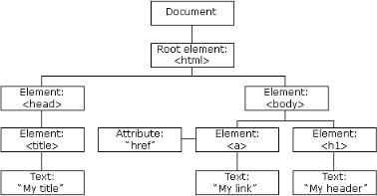

Intro to DOM
When a web page is loaded, the browser creates a Document Object Mode (DOM) of the page.
DOM, represents all page content as objects that can be modified.

Slide 4
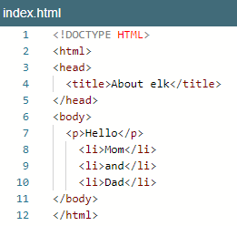
Intro to DOM
The DOM is the tree of HTML nodes.
It is a representation of what is rendered in the web browser.
We can change or create anything on the page using it.
The DOM specification explains the structure of a document and provides objects to manipulate it.

Slide 5
DOM tree
The backbone of an HTML document is tags.
According to the DOM, every HTML tag is an object.
Nested tags are “children” of the enclosing tag.
The text inside a tag is an object as well.
All these objects are accessible using JavaScript, and we can use them to modify the page.

Slide 6
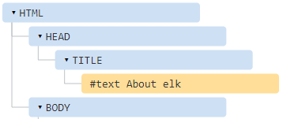
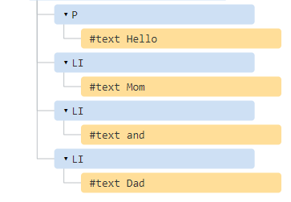
DOM tree
DOM structure

Slide 7
DOM tree
Nodes of DOM
Every tree node is an object.
Tags are element nodes (or just elements) and form the tree structure:
<html> is at the root node, then
<head> and <body> are its children, etc.
The text inside elements forms text nodes, labelled as #text.
A text node contains only a string. It may not have children and is always a leaf of the tree.
Spaces and newlines are totally valid characters, like letters and digits.
They form text nodes and become a part of the DOM.

Slide 8
Core Concepts of DOM
Node: Every part of the document is a node, including elements, attributes, and text. Nodes can be of various types like elements, text nodes, attribute nodes, etc.
Element: Elements are the most common type of nodes and represent the structure and content of the document. They can have attributes, child nodes, and content.
Attributes: Attributes provide additional information about elements and are represented as node properties.
Methods for Access and Manipulation: The DOM provides methods and properties to dynamically update web pages and creating interactive web applications.

Slide 9
Intro to DOM
For instance:
<!DOCTYPE html>
<html lang="en">
<head>
<title>My We</title>
<script src="app.js"></script>
</head>
<body>
<center>
<button onclick="changeBody()">
Ok
</button>
</center>
</body>
</html>
// change the background color to black after clicking button
function changeBody () {
document.body.style.background = “black";
setTimeout(() => document.body.style.background = "", 3000);
}
app.js
Index.html

Slide 10
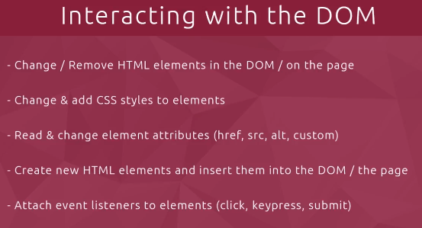
Why DOM???

Slide 11
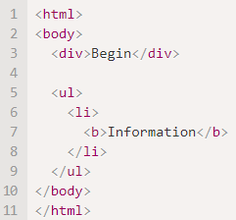
Children: childNodes, firstChild, lastChild
There are two terms that we’ll use from now on:
Child nodes (or children) – elements that are direct children. In other words, they are nested exactly in the given one. For instance, <head> and <body> are children of <html> element.
Descendants – all elements that are nested in the given one, including children, their children and so on.
For instance, here <body> has children <div> and <ul> (and few blank text nodes)
…And descendants of <body> are not only direct children <div>, <ul> but also more deeply nested elements, such as <li> (a child of <ul>) and <b> (a child of <li>) – the entire subtree.

Slide 12
Searching (Querying the DOM)
There are also other methods to look for nodes by a tag, class, name or the use of querySelector.
document.getElementsByID(‘id’) - returns elements that have the given CSS class name.
document.getElementsByClassName(‘className’) - returns elements that have the given CSS class name.
document.getElementsByTagName(‘tag’) - looks for elements with the given tag and returns the collection of them.
document.getElementsByName(‘name’) - returns elements with the given name attribute, document-wide. Very rarely used.
document.querySelector(‘css’) - returns the first element inside the document matching the given CSS selector.

Slide 13


innerHTML Property in DOM
innerHTML is a property in JavaScript that allows you to access or modify the HTML content inside an element:
innerHTML property represents the content between the opening and closing tags of an HTML element
as a string.
innerHTML gets the content in-between a targeted HTML element
This property can be used to dynamically update or retrieve the content of an element on a webpage.
It is easiest way to get the content of an element by getting or replacing the content of HTML elements.

Slide 14
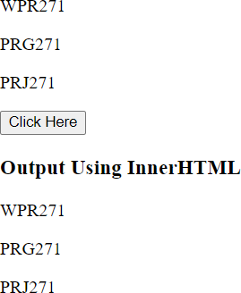
innerHTML Property in DOM
Say we have the following website:

Slide 15
getElementsByID(‘id’)
Example:
<body>
<div id="input">
<p>WPR271</p>
<p>PRG271</p>
<p>PRJ271</p>
</div>
<button onclick = "myFunction()" id="btn">
Click Here
</button>
<p id="output"></p>
</body>
// get content from HTML document, under tag with “input” ID
function myFunction(){
let text = document.getElementById("input").innerHTML; document.getElementById("output").innerHTML = text;
};
app.js
ID should be unique and can only be utilized once.
Index.html

Slide 16
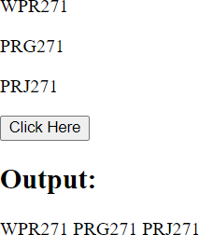
getElementByTagName(“tag”)
Say we have the following website:
We want to get all test from the form input elements.​
The text in the form input elements should then be manipulated
using getElementByTagName(“tag”) method, and display as shown:

Slide 17
getElementByTagName(“tag”)
document.getElementsByTagName(“tag") method is to retrieve a collection of tag elements on the page.
<body>
<div id="input">
<p>WPR271</p>
<p>PRG271</p>
<p>PRJ271</p>
</div>
<button onclick = "myFunction()" id="btn">
Click Here
</button>
<p id="output"></p>
</body>
function myFunction(){
// Accessing and modifying innerHTML using
//document.getElementsByTagName
let divElements = document.getElementsByTagName("p"); let content = "";
for (var i = 0; i < 3; i++) {
content += divElements[i].textContent + " ";
}
document.getElementById("output").innerHTML = content;
};
app.js
Index.html

Slide 18
getElementByTagName(“tag”)
The function retrieves all the elements within the div tag, using getElementsByTagName("p").
It loops through each <p> element, extracts its text content using the textContent property, and stores it in the divElements[] array.
Finally, it stores each text value from the <p> in a string called content, after concatenating it with an empty string.
Finally, the innerHTML of the "output" <p> element is set to the concatenated content of the elements.

Slide 19
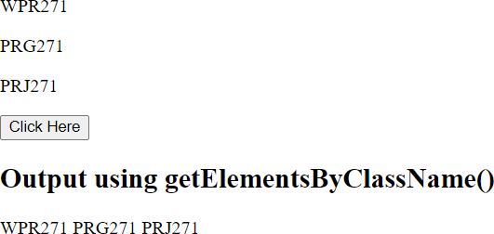
getElementByClassName(“name”)
Say we have the following website:
We want to get all test from the form input
elements.​
The text in the form input elements should then be manipulated using the getElementByClassName(“classname”) method, and display as shown:

Slide 20
getElementByClassName(“class”)
document.getElementsByClassName(“tag") method is to retrieve a collection of tag elements on the page.
<body>
<div class="myText">
<p>WPR271</p>
<p>PRG271</p>
<p>PRJ271</p>
</div>
<button id="outputButton" onclick="useClassName()">
Click Here
</button>
<p id="output"></p>
</body>
function useClassName() {
var myDiv = document.getElementsByClassName("myText");
let paragraphText = "";
for (var i = 0; i < myDiv.length; i++) { paragraphText += myDiv[i].textContent + " ";
}
document.getElementById("output").innerHTML = paragraphText;
}
index.html:
app.js:

Slide 21
getElementByClassName(“class”)
We utilized the useClassName() function, which is triggered when the "Click Here" button is clicked.
The function uses document.getElementsByClassName("myText") to retrieve all elements with the class name "myText".
It loops through each element, extracts the text content, and stores it in the myDiv[], which is an array.
We then use the textContent property to get or set the text content of an HTML element.
textContent returns a string that includes all the textual content within the specified element.
Finally, the innerHTML of the "output" <p> element is set to the concatenated content of the elements in the "myText" class.

Slide 22
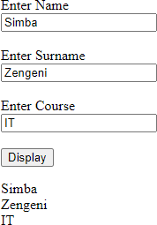
getElementByName(“name”)
Say we have the following website:
We want to get all test from the form input elements.
The text in the form input elements should then be manipulated using getElementByName(“name”) method, and display as shown:

Slide 23
getElementByName(“name”)
The getElementsByName() method is primarily used to select elements based on their name attribute, which is more commonly associated with form elements like input fields, radio buttons, and checkboxes.
<body>
<div id="input">
<label for="">Enter Name</label><br>
<input type="text" name="details" ><br><br>
<label for="">Enter Surname</label><br>
<input type="text" name="details" ><br><br>
<label for="">Enter Course</label><br>
<input type="text" name="details"><br><br>
</div>
<button onclick="myFunction()" id="btn"> Display
</button>
<p id="output"></p>
</body>
function myFunction() {
var input = document.getElementsByName("details");
var inputArray = [];
for (var i = 0; i < input; i++) {
var inputValue = input[i].value;
inputArray.push(inputValue);
}
var output = document.getElementById("output");
output.innerHTML = inputArray.join("<br>");
}
app.js
Index.html

Slide 24
getElementByName(“name”)
We utilized myFunction(), which is triggered when the “Display" button is clicked.
The function uses document.getElementsByName("details") to retrieve elements from the input tags, using the attribute name, with name value: “details".
It loops through each element, extracts the text content in the input elements, and stores it in the
inputArray[] array.
We then use the .value property returns the current value of an HTML input element. The value property is used to access or modify the content of an input element, such as text entered into a text field, the selected option in a dropdown, or the value of a radio button or checkbox.
inputValue returns a string that includes all values from input, and pushes it into an array, which uses join(“<br>”) to concatenate each value.
Finally, the innerHTML of the "output" <p> element is set to the concatenated content of inputArray[].

Slide 25


querySelector()
querySelector() is a JavaScript method that allows you to select elements in the DOM using CSS-like selectors.
It can select elements based on various criteria such as tag names, class names, IDs, attribute values, and more.
The basic syntax of querySelector:
document refers to the root of the DOM, i.e., the entire HTML document.
selector is a string representing the CSS selector you want to use to select elements.

Slide 26
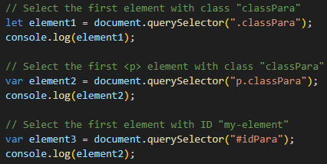

querySelector()
Examples of querySelector usage:

Slide 27
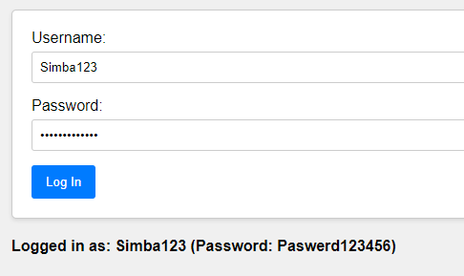
querySelector [ID]
Create the following form:

Slide 28
querySelector [ID]
Functionality:
1) A user should enter their username and password.
The "Log In" button has an onclick attribute that calls the login() function when clicked.
Inside the login() function, we must use querySelector() to select the input fields by their IDs ('#username' and '#password').
The values of the input fields must be retrieved using the value property.
The retrieved values are then stored in an object called user.
Finally, the concatenated result is displayed in the <p> element with the ID 'output'.

Slide 29
querySelector [ID]
<body>
<form id="loginForm">
<div class="input-container">
<label for="username">Username:</label>
<input type="text" id="username" name="username">
</div>
<div class="input-container">
<label for="password">Password:</label>
<input type="password" id="password" name="password">
</div>
<button type="button" onclick="login()" id="loginButton">
Log In
</button>
</form>
<p id="output"></p>
</body>
Styles.css file is on Moodle
Index.html

Slide 30
querySelector()
function login() {
var usernameInput = document.querySelector('#username');
var passwordInput = document.querySelector('#password');
var user = {
username: usernameInput.value, password: passwordInput.value
};
var output = document.querySelector('#output');
output.textContent = "Logged in as: " + user.username + " (Password: " + user.password + ")";
}
app.js

Slide 31
querySelector [Class]
<body>
<form class="login-form">
<div class="input-container">
<label for="username">Username:</label>
<input type="text" name="username">
</div>
<div class="input-container">
<label for="password">Password:</label>
<input type="password" name="password">
</div>
<button type="button" onclick="login()" class="login-button"> Log In
</button>
</form>
<p class="output"></p>
</body>
The classes 'login-form', 'input-container', 'login-button', and 'output' have been applied to the corresponding elements in the HTML.
Styles.css file is on Teams
Index.html

Slide 32
querySelector [ID]
function login() {
var form = document.querySelector('.login-form');
var usernameInput = form.querySelector('[name="username"]'); var passwordInput = form.querySelector('[name="password"]');
var user = {
username: usernameInput.value, password: passwordInput.value
};
var output = document.querySelector('.output');
output.textContent = "Logged in as: " + user.username + " (Password: " + user.password + ")";
}
app.js

Slide 33
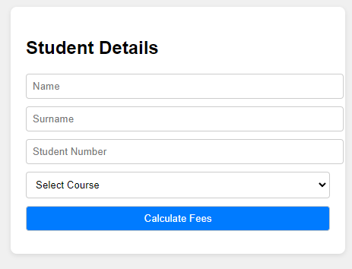
Exercise
Use the addendum (html and css files provided) to create the following application.
A student can either be in diploma or degree.

Slide 34
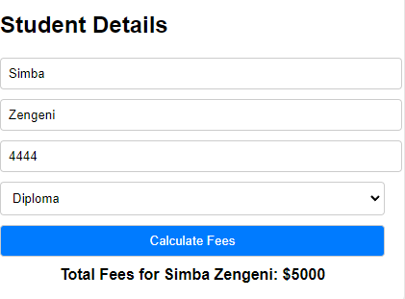
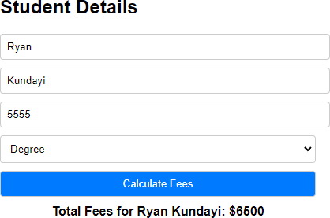
Exercise
If the student is diploma, then fill in their details and its displayed
If the student is degree, then fill in their details and its displayed
Validate, in JavaScript, all entries made before displaying.

Slide 35
Thank You!
The End
/belgiumcampusSA
#Belgium Campus
info@belgiumcampus.ac.za
+27 10 593 53 68
/belgiumcampus

